Slide 1
JSTANKS
GROUP 6
ALEX PAVI & VIREN

Slide 2
Original Game - Overview
Developed by aleks1
Found on Git
Programmed in Java (Running Environment required on platform)
Minimum portability
User requires maintenance
Requires downloading of source code

Slide 3
Original Game - Details
Tank shooter
2D graphics
Map containing user tanks, enemy tanks, and walls
Simple Free for All game mode
Poor User Interface

Slide 4

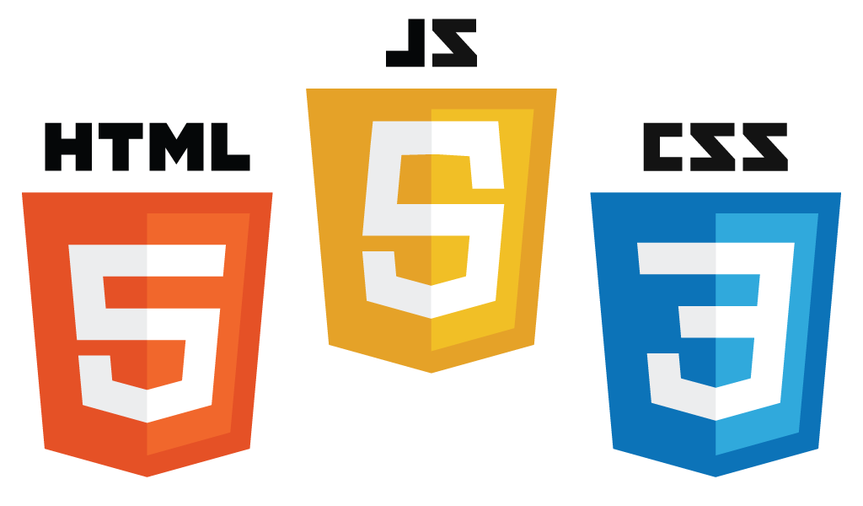
Platform Independence

Slide 5







Platform Independence

Slide 6

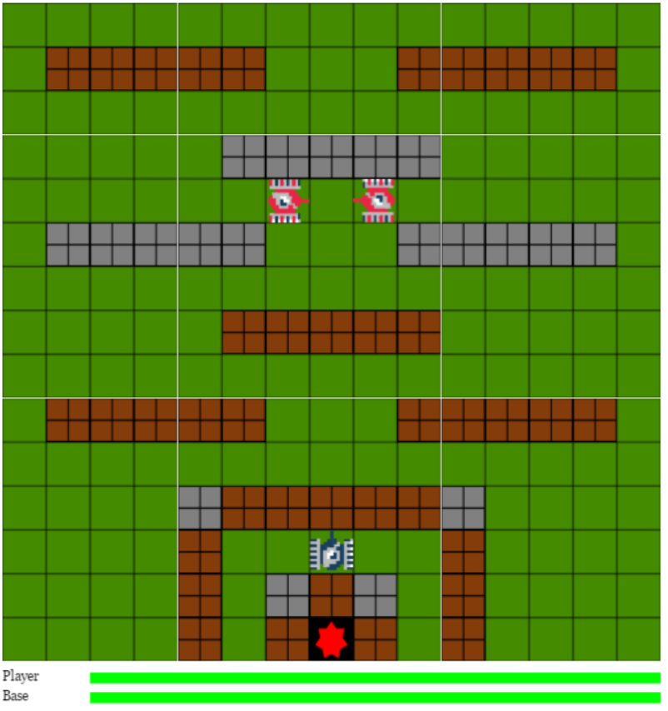
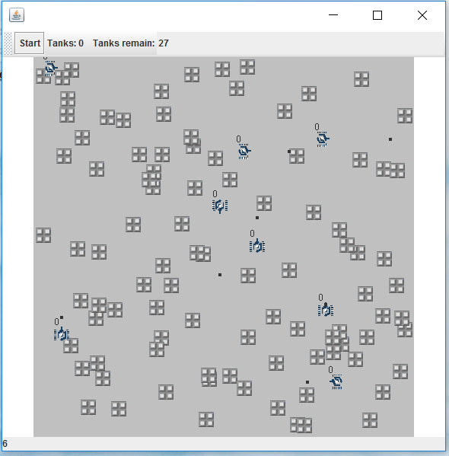
Performance

Slide 7
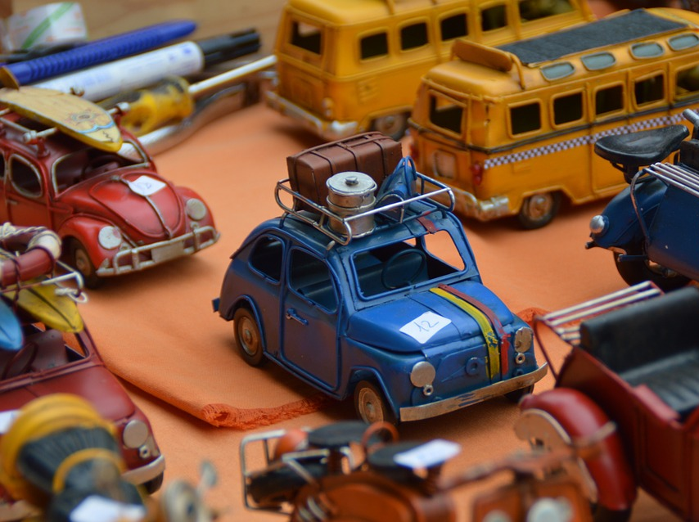


The Process
Pre-Rendering
Pre-Loading
Pre-Building

Slide 8
Features
Objective Added
End Game
Aesthetic
Levels
Maps
Menus

Slide 9
Objective Added

Slide 10
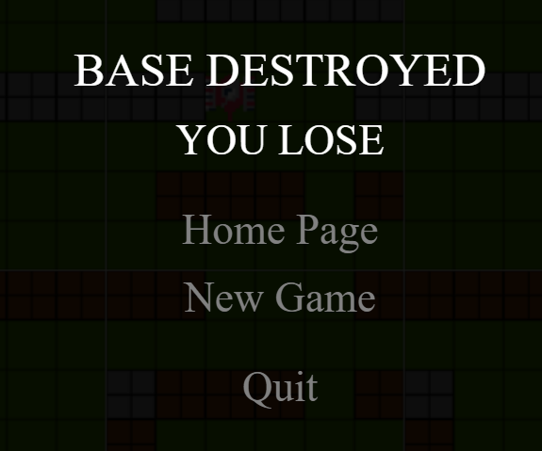
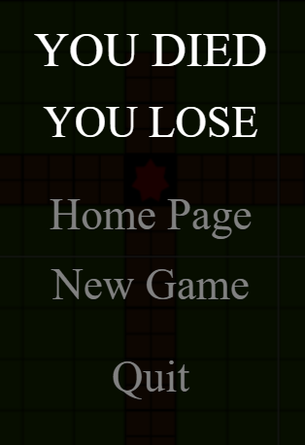
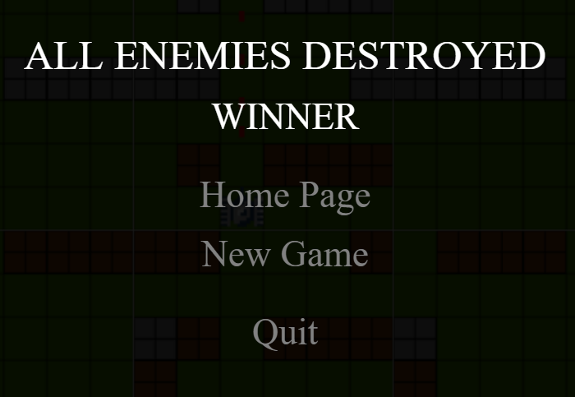
End Game

Slide 11
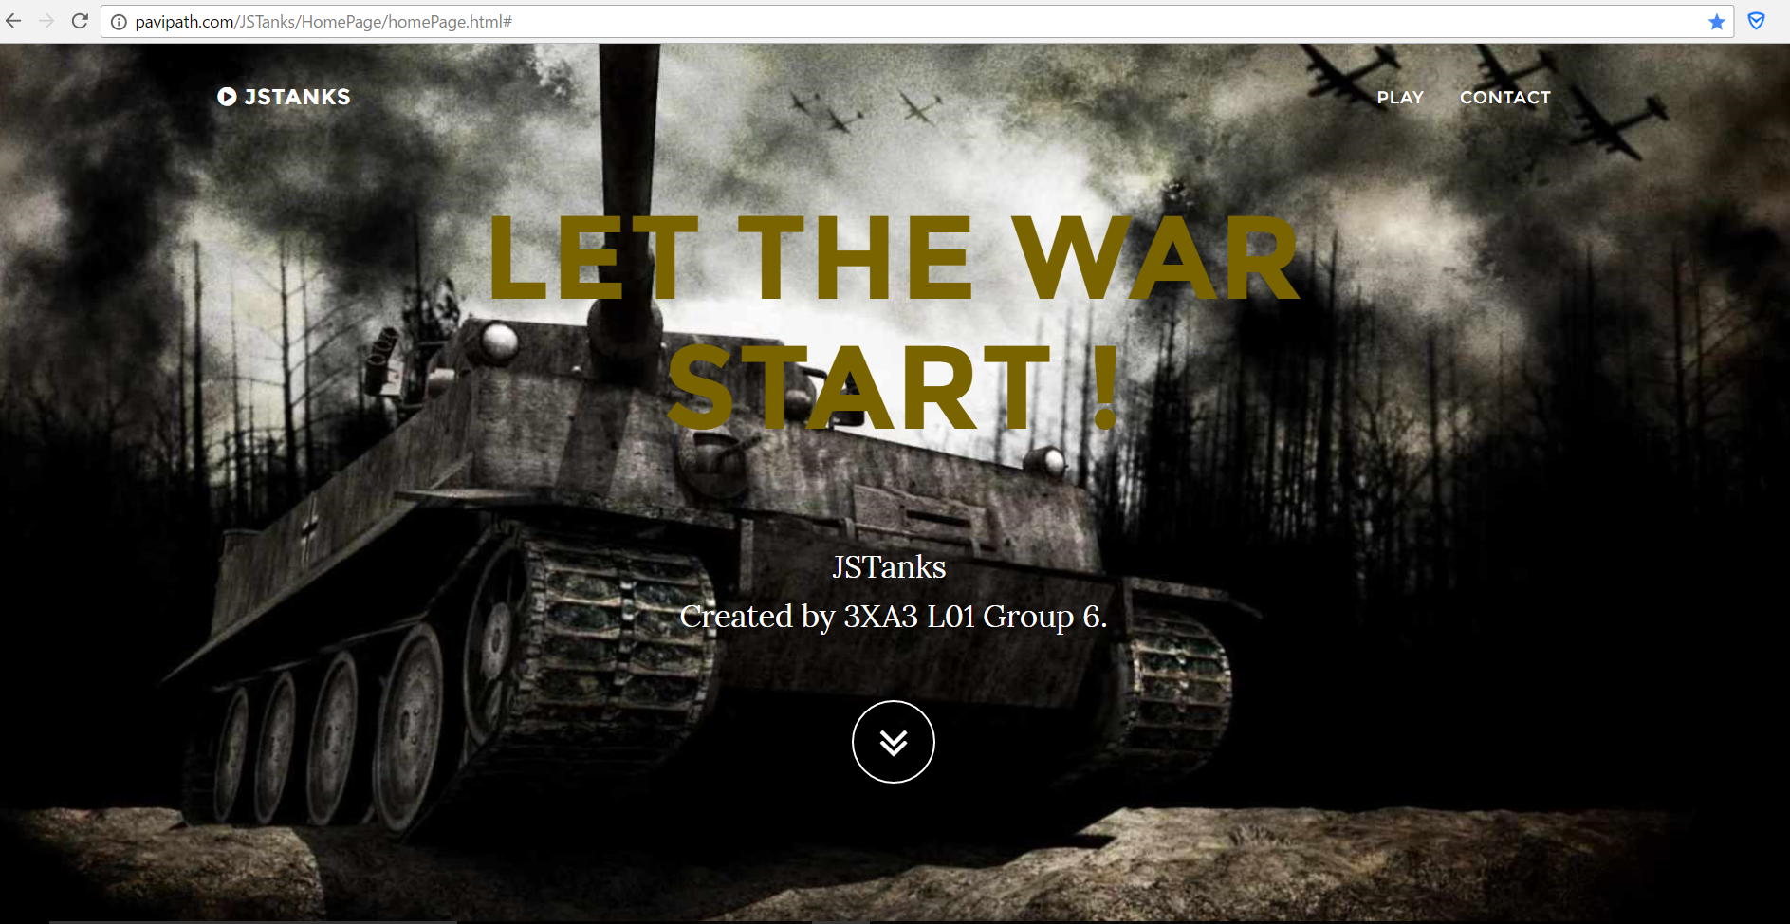
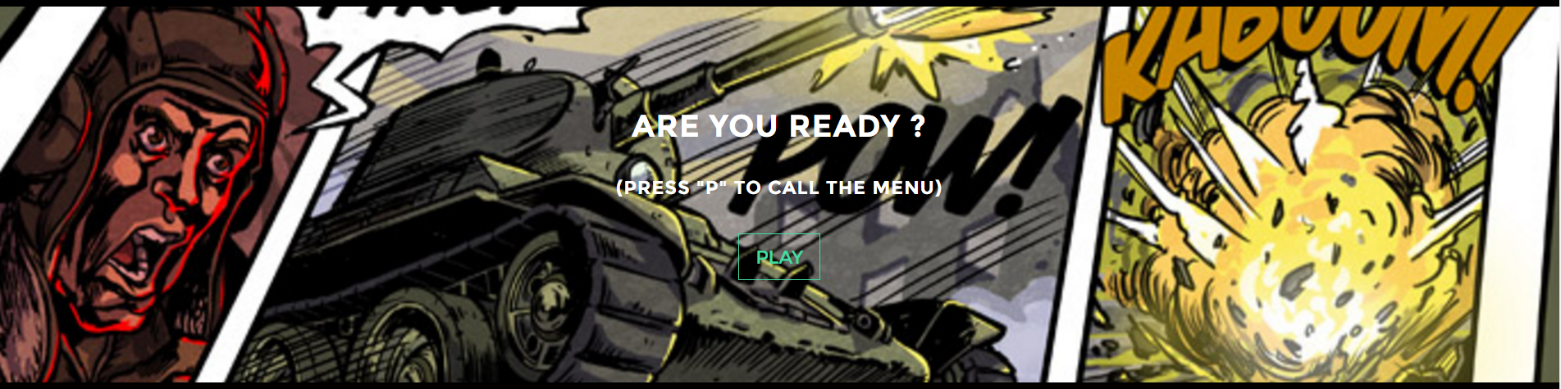
Aesthetic

Slide 12
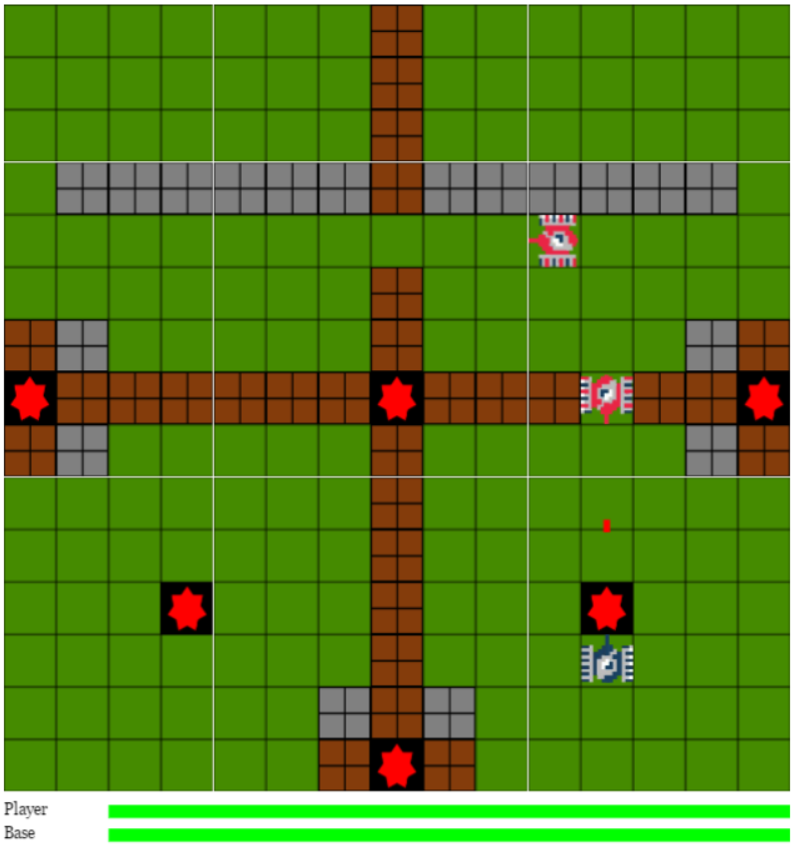
Levels & Maps

Slide 13
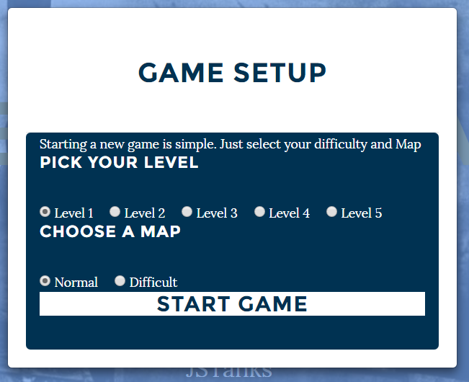
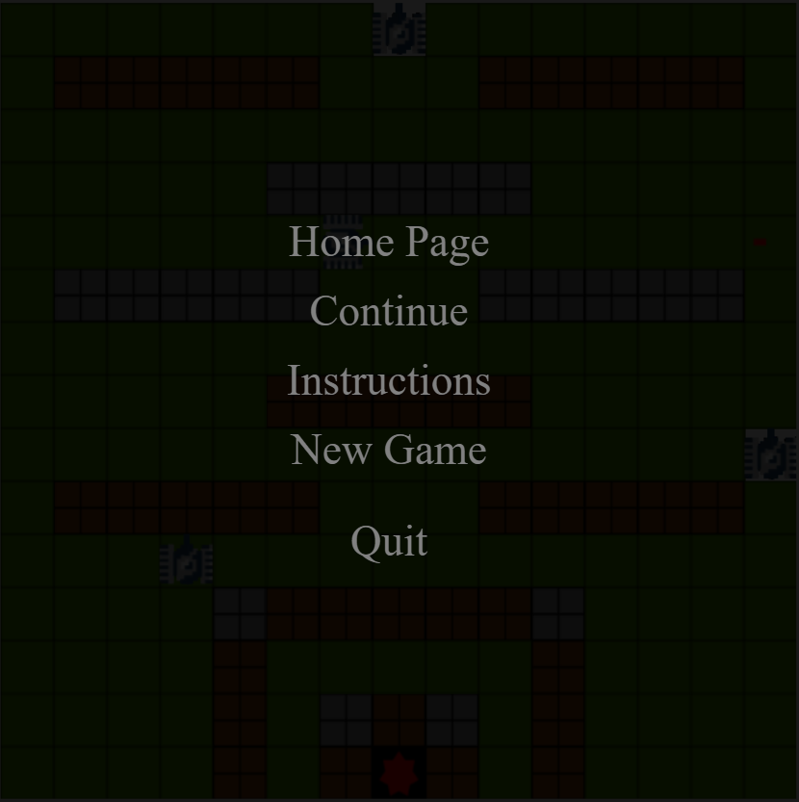
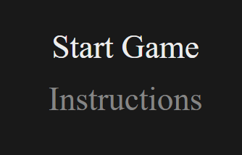
Menus

Slide 14
DEMONSTRATION
JSTank.tk

Slide 15
THANK YOU

